Slide 1
Shell Bootcamp 2024 3 Reflections for Week #1
Achal Shankar Gupta
Date : 30-Aug-2024

Slide 2

About Me
“I am not afraid of storms for I am learning how to sail my ship.”

Slide 3

My learnings from this week!

Slide 4

Learning 1 | My takeaways
The importance of a growth mindset, grooming, and proper etiquette in meetings, chats, and emails for building a professional image in the corporate world.
Cultivating a professional attitude, mindset, and proper communication skills is essential for career growth and success, especially when interacting in corporate settings.
In the Energy sector, professionalism ensures safety, teamwork, and adherence to industry standards for reliable and efficient operations. Having a growth mindset encourages innovation, which is important for adapting to industry changes like renewable energy solutions and digital transformation.

Slide 5

Learning 2 | My takeaways
I got insights into stakeholder management, emphasizing the identification of stakeholders, understanding their expectations, and building trust.
Effective stakeholder management relies on identifying key players, addressing their needs, and using trust-building techniques to foster long-term loyalty and collaboration.
In the energy sector, stakeholder management is crucial, as projects involve multiple parties such as regulators, communities, customers, and internal teams. Understanding their varying levels of interest and influence helps in managing expectations, ensuring compliance, and building trust, all of which are essential for project success and maintaining industry relationships.

Slide 6

Learning 3 | My takeaways
I got to learn about key aspects of business analysis, including SDLC, requirement analysis, Agile methodologies like Scrum and Kanban, and tools like burndown and velocity charts for tracking progress..
Mastering requirement analysis and Agile methods is essential for efficiently managing projects and adapting to changes throughout the development process..
In the energy sector, effective requirement management and Agile practices ensure that complex projects are aligned with business needs and delivered on time, while tools like Scrum boards help teams track progress and stay organized.

Slide 7

Relevance of learnings for my organization

Slide 8

Learning 1 | Relevance for Shell
Shell likely emphasizes professionalism through clear communication, effective meeting etiquette, and a focus on growth across its global teams. I believe this might be the key to managing large-scale energy projects, where teamwork, timely decisions, and maintaining high standards help build trust with stakeholders and ensure smooth operations.

Slide 9
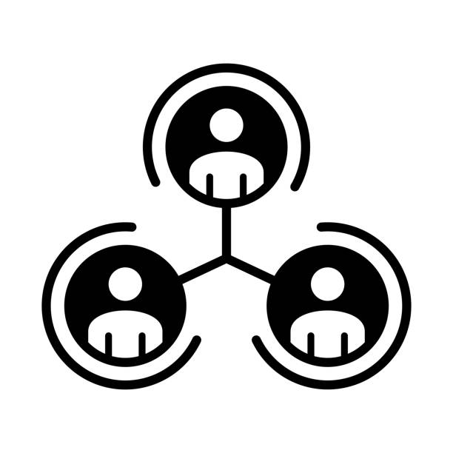
Learning 2 | Relevance for Shell
Stakeholder management is important at Shell, especially as the company shifts towards cleaner energy. By mapping stakeholders like regulators, investors, and communities with tools like the power-interest grid, Shell might address key concerns while maintaining trust and long-term relationships.

Slide 10

Learning 3 | Relevance for Shell
Shell likely uses business analysis techniques like SDLC and Agile methods to manage its complex projects. Tools like Scrum, Kanban, and requirement modeling help teams stay organized and flexible in delivering solutions across different operations.

Slide 11

Challenges in implementing learning

Slide 12

Challenge faced while implementing Learning 1
I’ve realized that I struggle to clearly communicate my thoughts and opinions, which suggests a need for a stronger growth mindset. In future sessions, I plan to take a more active role to begin improving this.

Slide 13

Challenge faced while implementing Learning 2
While identifying the stakeholders in my life, I noticed I couldn’t think of as many as I should have. Moving forward, I intend to practice more self-reflection to better recognize the people who have invested their time and energy in me.

Slide 14

Challenge faced while implementing Learning 3
Having been a solo worker for a while, I’ve found it challenging to adjust to a team setting when we were required to simulate an agile environment. In upcoming team activities, I aim to participate more actively and contribute meaningfully to the group.

Slide 15

Action Plan

Slide 16
My Action Plan for this Week
Actions
Timeline
Status
In upcoming sessions, I will actively participate by sharing my thoughts more frequently and seeking feedback to foster a growth mindset.
Start immediately and aim to consistently engage in all sessions for the remainder of the training period.
By the end of this week, I have participated more in the technical sessions, contributing to discussions and sharing my opinions.

Slide 17

Learning is also Fun!

Slide 18
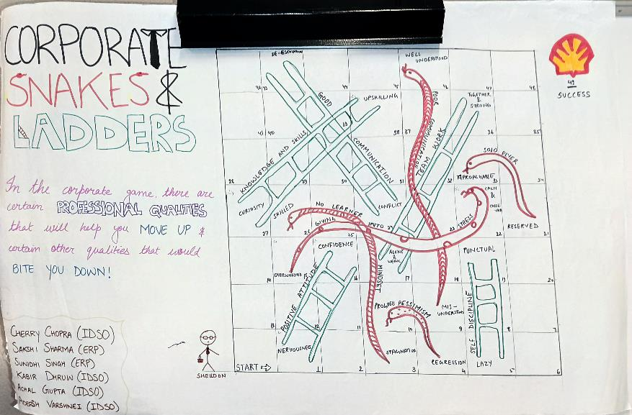
Learning is also Fun!
This week, learning was a lot of fun because we did several role plays during our sessions, and many of them were incredibly creative and hilarious. Our group also created a Snakes & Ladders visual to represent the various professional qualities that one needs to climb the corporate ladder.

Slide 19

Summary
This week focused on developing soft skills like professionalism, stakeholder management, and technical skills including business analysis and agile methodology through interactive sessions and activities like role plays.
The upcoming week will dive into foundational technical knowledge such as DBMS, DevOps, and Software testing, which are crucial for building strong technical expertise in the energy sector.
The communication, teamwork, and stakeholder management skills learned this week will directly support technical collaboration and the foundations of SDLC, requirement analysis and agile methodologies will help in areas like DevOps and software testing.

Slide 20
Thank You

